Slide 1
Wheel Encoder(right)
Computer Interface
Feedback for distance tracking
SSH
Data output
from SLAM
algorithm
Right Motor
Driver Chip
User input
Left Motor
Arduino
Wheel speed
Pi
PWM signal
Motor Control
Instructions to control
motor speed
Slam Algorithm
Distance Tracking
Serial
Communication
Visual Feedback
Wheel Encoder(left)
Feedback for distance tracking
Legend
Data of mapped
environment
Serial Communication
Instruction regarding
when to operate
LIDAR

Slide 2
Wheel Encoder(right)
Computer Interface
SSH/Web Interface
Data output
from SLAM
algorithm
Right Motor
Driver Chip
User input
Left Motor
Arduino
Wheel speed
Pi
PWM signal
Motor Control
Instructions to control
motor speed
Slam Algorithm
Distance Tracking
Serial
Communication
LIDAR data
Wheel Encoder(left)
Feedback for distance tracking
Data of mapped
environment
Serial Communication
Instruction regarding
when to operate
LIDAR

Slide 3
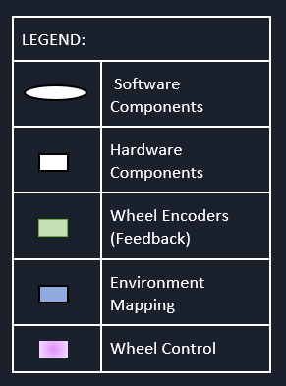
<<Computer Interface>>
<<SSH/Web Interface>>
Data output
from SLAM
algorithm
User input
<<Motor Driver>>
Driver Chip
<<Serial Communication>>
<<Arduino>>
Wheel speed
<<Pi>>
PWM signal
Left
Motor
Right Motor
Motor Control
Instructions to control
motor speed
Slam Algorithm
Distance/
Angle Tracking
<<Serial Communication>>
LIDAR data
Wheel Encoder(left)
Wheel Encoder(right)
Data of mapped
environment
<<Serial Communication>>
Instruction regarding
when to operate
Feedback for distance/angle tracking
LIDAR

Slide 4
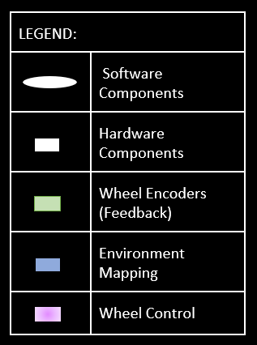
<<Computer Interface>>
<<SSH/Web Interface>>
Data output
from SLAM
algorithm
User input
<<Motor Driver>>
Driver Chip
<<Serial Communication>>
<<Arduino>>
Wheel speed
<<Pi>>
PWM signal
Left
Motor
Right Motor
Motor Control
Instructions to control
motor speed
Slam Algorithm
Distance/
Angle Tracking
<<Serial Communication>>
LIDAR data
Wheel Encoder(left)
Wheel Encoder(right)
Data of mapped
environment
<<Serial Communication>>
Instruction regarding
when to operate
Feedback for distance/angle tracking
LIDAR

